Slide 1
Alkalmazások a jövő adatközpontjának kulcsai
Strausz János – Cisco Systems
01.10.2019

Slide 2








Alkalmazások, a vállalat arca ügyfelei felé
Hogy állunk a meglevő szolgáltatásokhoz viszonyítva?
Notes:
Today, applications are what's driving customer engagement.
And the way that customers connect to the business is through the code that you write.
Customers demand flawless performance.
And they are loyal to the business that deliver it.
<CLICK>
But this is the new battleground. Your competitive landscape is growing…
As customers expectations are are growing
Being driven by the expectation of flawless performance of todays applications
To illustrate that Nordstrom saw online sales fall 11% when its website response time slowed by just half a second
(says Gopal Brugalette, who was the retailer's senior applied architect in performance engineering at the time.)

Slide 3

Meg kell tanulni alkalmazkodni az ügyfeleink ígényeihez, kiszolgálásához,
Every Business is a Software Business
Do you know what our busiest bank branch is in the UK? It’s our mobile app on the 7:15 am train to Paddington.
Notes:
…And You Need to Keep Pace with Your Customers..
You have to move fast, where your customers are moving and you have to move faster.
Customers want what they want, when they want it and they expect to get it.
And every industry from consumer goods, to healthcare, to manufacturing to banking is investing in digital strategies to meet and exceed customer expectations.
this is a slide I tend to always present , regardless of whether you are in the finance sector or not because
I think you can see this change most clearly in what the CEO of RBS said when he called his business branch the 7:15 train from Paddington Station…
It's no longer just about that hot tech start-up, every company is now a software company.
John Deere tractors today now ship with more software in them than the original space shuttles did…. and AppDynamics lets them do just that.
lets them do just that.

Slide 4

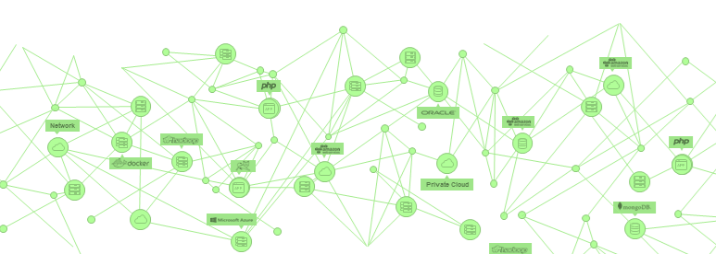
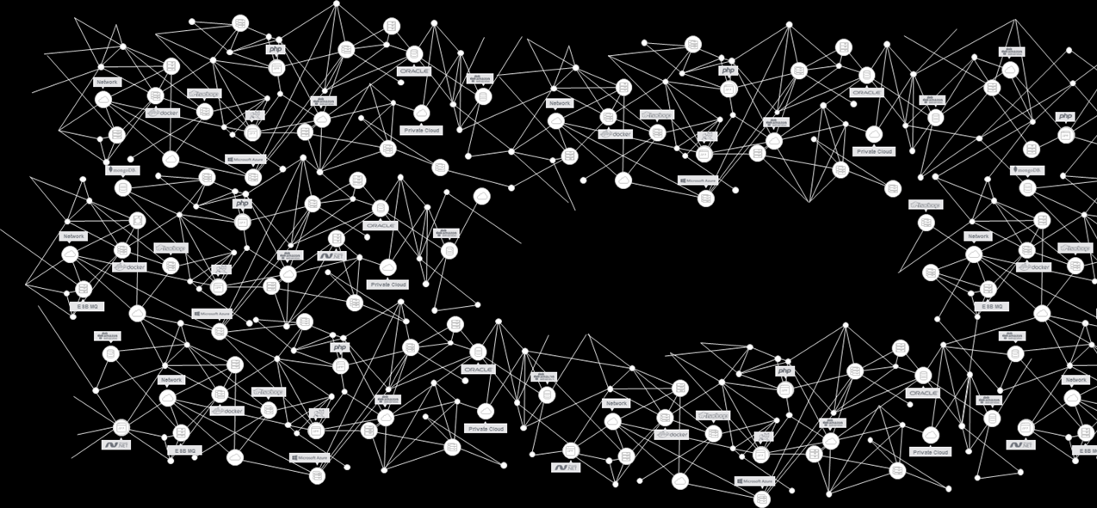
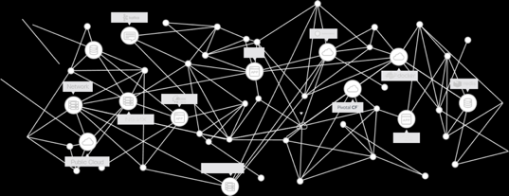
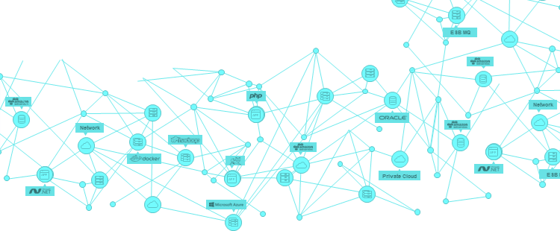
ALKALMAZÁSOK számossága és komlexitása robbanásszerűen növekszik.
Private Cloud
AWS
Cloud
1
Nagyobb komplexitás
Több komponens
2
Több függőség
Nagyonn kitettség
3
Gyors fejlesztés
Rövidebb életciklusok
4

Slide 5



Üzemeltetés, problémamegoldás
Conversion rates
are dropping
Definitely not
the database
Checking
the logs
Right now
This app is horrible!
RETWEETS
LIKES
Which customers are affected?
140
1053
Why is this happening?
Database
looks fine
Spend is
down
The War Room
The Business War Room
Notes:
These siloed tools continue into the war room
[a room typically similar to the boardroom we are sat in today?]
where siloed problem solving continues typically without actual identification of the problem
and typically with no way to communicate with a common understanding of KPIs for the customer experience.
In the DevOps War Room; Networks, Servers, Database, IT technical metrics are all green…
Lets play the blame game and point the finger at the database or the network guy
Worse still is when there is a separate war room happening down the corridor with all of the business folks
In the Business War Room: No pricing changes, no design changes, no marketing changes…
Meanwhile, conversion rates go down…
The problem isn’t identified. Siloed teams can’t see the customer journey.!
Does this happen to you?

Slide 6



















Minden tranzakció folyamatos követése
App iQ
App iQ
Map
Move Fast,
Follow Everything &
Focus on What Matters Most
Baseline
Diagnose
Enterprise
Private Cloud
Network
Business iQ
Lightweight Agents
Deployed Throughout Application Environment
Auto Instrument | Auto Configure
Public Cloud
Notes:
On the left I will walk you through the core engines behind what we do starting with MAP iQ
To install AppDynamics you deploy small, lightweight agents throughout your application environment
These agents ten automatically discover and map the business transaction (100% of user interactions - your full application topology!)
<CLICK>
Dynamically discover and map the user’s transaction end-to-end across the application stack.
In any environment - across AWS, MSFT Azure, Google cloud platform, or across multiple clouds
So that IT, business, and development teams see the connections between end-users and the application environment in a business context
And you can see the user journey - from log-in to authentication, user profile, and data source and query across hundreds or thousands of servers and databases
<CLICK>
Customers who see this often don’t believe how easy it is.
We often hear stories of disbelief and that’s why we invite you to try it
Voda story
Prod connected to pre-prod story

Slide 7




Minden tranzakció folyamatos követése
App iQ
Map
Move Fast,
Follow Everything &
Focus on What Matters Most
Baseline
Diagnose
Enterprise
Private Cloud
Network
Business iQ
Every User,
Every Transaction
Automates Discovery and Correlation
Dynamically Updated
Public Cloud
Notes:
On the left I will walk you through the core engines behind what we do starting with MAP iQ
To install AppDynamics you deploy small, liteweight agents throughout your application environment
These agents ten automatically discover and map the business transaction (100% of user interactions - your full application topology!)
<CLICK>
Dynamically discover and map the user’s transaction end-to-end across the application stack.
In any environment - across AWS, MSFT Azure, Google cloud platform, or across multiple clouds
So that IT, business, and development teams see the connections between end-users and the application environment in a business context
And you can see the user journey - from log-in to authentication, user profile, and data source and query across hundreds or thousands of servers and databases
<CLICK>
Customers who see this often don’t believe how easy it is.
We often hear stories of disbelief and that’s why we invite you to try it
Voda story
Prod connected to pre-prod story

Slide 8

Hibakeresés mielőtt az ügyfél jelezné azt.
App iQ
Map
Move Fast,
Follow Everything &
Focus on What Matters Most
Baseline
Diagnose
Enterprise
Private Cloud
Network
Business iQ
Automatic Baselines for Every Metric
Machine Learning Anomaly Detection
Prevent IT Alert Storms
Public Cloud
Notes:
Next with Baseline iQ…
The AppD agents then gather detailed performance information
and we automatically create a dynamic baseline of what "normal" looks like
So when performance deviates from any of these baselines, alerts are automatically generated so you know there is an issue before your customer does.
<CLICK>
This results in IT Alert Storm prevention based on “baseline” anomaly detection from what is normal at any given time of the hour, day, week, month or year...
But AppDynamics will automatically baseline each and every metric we collect
Whether that's performance and response times
Volumetrics
Or Business metrics like the shopping cart totals
or conversion rates expected at a given part of the day
Anything we collect we baseline automatically and can be triggers for alerting or other auotmation rules like cloud orchistration

Slide 9

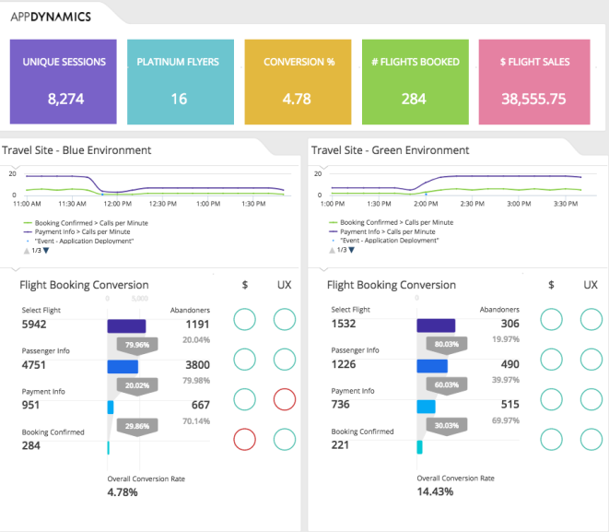











Real Time
Performance Intelligence
Total Cost $1,800
App iQ
App iQ
Map
Move Fast,
Follow Everything &
Focus on What Matters Most
Baseline
Business iQ
Diagnose
Business iQ
Enterprise
London
Business iQ
Automatically Collected
Fully Correlated
Ready for Real-Time Insights
Travel Airways API
Mike Smith
Platinum Customer
Notes:
Business iQ at the where the application and the business meet. Where business is being won or lost.
And it’s through the business transaction - this unifying context…
<CLICK>
We automatically correlate the right data and right the code that’s streaming through the end-user experience, and application and infrastructure performance, and make it immediately available…
<CLICK>
…so you can understand and act on whats happening in your business now, every moment.
<CLICK>
(Top left) Business health for key user journeys
Monitor the real-time business health performance for each step of your key user journeys
<CLICK>
(Bottom left) Correlated UX and business performance KPIs
Compare user experience indicators over time…
With business metrics side-by-side.
In this example, we see that a negative user experience (response time / errors) on payment info is having a $ impact to confirmed bookings…
...and we can drill in using APM etc. to remediate.
<CLICK>
(Bottom right) “Blue” / “Green” release validation
Here, you can compare two release versions of an application and…
Understand and measure changes to the environment in real time...
…in this example, the Travel customer pushed a new version of code to their "Green" deployment to fix their conversion issues…
...and see the positive impact immediately
You can see the change in user experience and conversion rates for each step of your key user journeys.
Release validation can help you create a business case for any feature.
As you can see, Business iQ is more than a pretty picture; this is real power.
Other use-case examples:
Business Health Monitoring: Understand and act on real-time mission critical and strategic business insights to improve outcomes.
Customer Segment Monitoring: Monitor, control and prioritize segmented customer experiences to improve SLA, service adoption, and other performance KPIs.
Release Validation: Compare, interrogate, and validate production code releases based on application, customer experience, and business KPIs
User Journey Monitoring: Understand performance metrics and business impact of a sequential order of customer events

Slide 10





















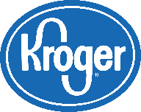














Every Company is a Software Company
The World’s Leading Enterprises Use AppDynamics Today
Financial
Services
Communications
& Entertainment
Consumer
& Retail
Technology
& Software
Business Services
& Insurance
Travel &
Logistics
Notes:
Quick slide to show this is game time application for business relevance

Slide 11


App iQ
Business iQ
Focus on What Matters Most
Move Fast
Follow Everything
Auto-discover and Map
No Manual Configuration
Baseline Every Metric
Production Monitoring
Low Overhead
All User Transactions
Unified Platform
One Consistent UI
Real-time Context
Notes:
We help you continuously deliver with the quality & pace required to match the hyper agile pace customers expect
We do this by unifying applications and business performance for operations, development, and business teams
<CLICK>
We help you transition from siloed focus on server or infrastructure health, to instrumenting your business (the business of IT) end-to-end - correlating end-user experience and app performance to business outcome
Now:
Operations teams can focus on performance end-to-end, in context of the business, instead of monitoring individual services.
Developers are now able to quickly diagnose and determine root cause by viewing stack traces, database calls and correlated log statements, releasing quality code faster.
And business owners can now monitor real-time business performance metrics, such as revenue and conversion rates.
This is why it's such an exciting time for YOU
IT is emerging as the difference maker in digital transformation.
No longer in a supporting role for the business, but a true partner being called on to drive the business.
NOTES:
Move fast. Monitor and improve every line of code and directly understand the impact it’s having on your users and your business in real time.
Follow everything. Data and code from every business transaction and every user journey is automated and prepared to deliver real-time intelligence that is contextual, actionable, and unifying.
Focus on what matters most. Application and business KPIs reflect opportunities and risks for complete services, not component tasks, and show teams what’s happening on the front lines - where the app and business converge and where customers can be won or lost every moment.

